Slide 1

Asbestos Awareness Training
49 CFR 1910.1001
49 CFR 1926.1101
Notes:
This PowerPoint presentation is intended for the training of BYU-Idaho employees who may have occasion to conduct maintenance or custodial activities near asbestos containing materials. The examples of asbestos containing materials given in this presentation are not all-inclusive and workers should always check the university asbestos file in the Physical Plant Office or contact the safety officer before disturbing any materials that could possibly contain asbestos.

Slide 2
What is Asbestos?
Where does it come from?
What is it used for?
Why is it regulated?
What are its health effects?

Slide 3
Definition:
Asbestos is a generic name given to a number of naturally occurring hydrated mineral silicates that possess a unique crystalline structure, are incombustible in air, and are separable into fibers.
Notes:
Asbestos is essentially fire resistant and was used in many building materials to help fireproof the construction materials.

Slide 4
Types of Asbestos
Actinolite
Anthophyllite
Amosite: (Brown Asbestos)
Chrysotile (Serpentine)
Crocidolite
Tremolite
Notes:
Chrysotile, Amosite and Tremolite are the three primary types of asbestos that are found in most building materials.

Slide 5
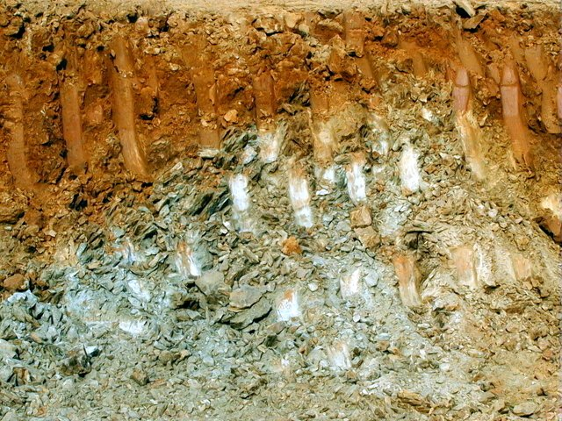
Naturally Occurring Asbestos
Notes:
Asbestos is a naturally occurring silicate that can be incidentally unearthed in mining operations. High concentrations of asbestos were experienced in vermiculite mining operations in Libby, Montana for many years.

Slide 6
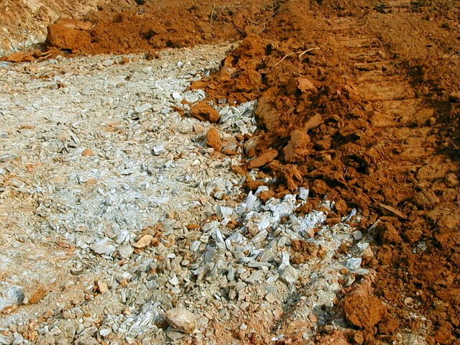
Crushed Asbestos Rock
Notes:
This is an example of a large vein of asbestos silicates exposed during an excavation operation.

Slide 7
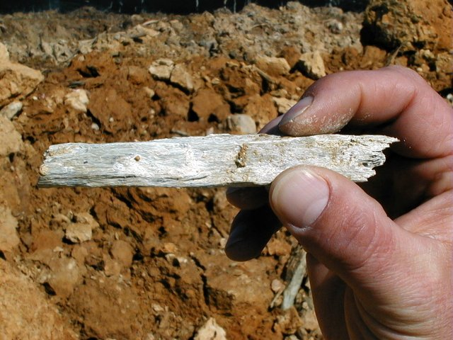
Natural Asbestos
Notes:
Asbestos tends to be concentrated in bundles that can be broken apart into microscopic fibers.

Slide 8
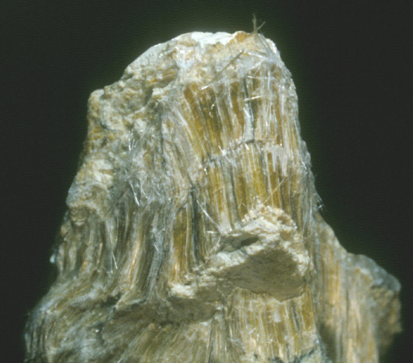
Natural Asbestos Fiber Bundle
Notes:
In large concentrations, the threadlike nature of asbestos fibers can be observed. When broken up, small pieces of fibers are generally not discernable.

Slide 9
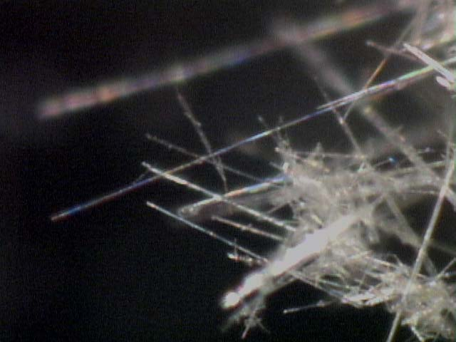
Microscopic View of Asbestos Fibers
Notes:
Asbestos fibers cannot generally be seen with the naked eye and must be identified with a microscope.

Slide 10
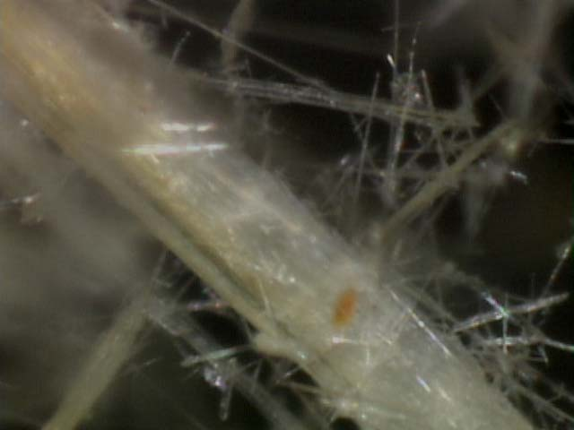
Microscopic View of Asbestos Fibers
Notes:
Asbestos fibers can be fractured into microscopic spear-like particles that can become airborne.

Slide 11
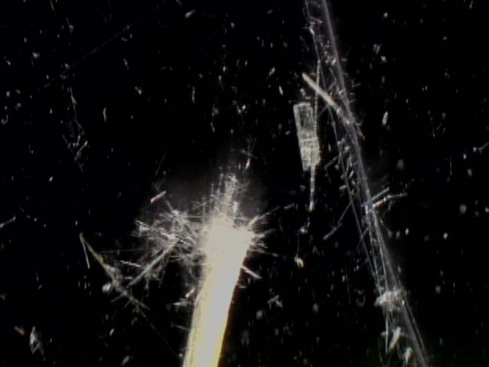
Microscopic View of Fractured Asbestos Fibers
Notes:
Inhalation of asbestos fibers causes the spear-like fibers to become embedded in the air sac or alveoli of the lungs, creating scare tissue and retarding the respiration process.

Slide 12
Asbestos Exposure Limits
Definition of Fiber: 5 micrometers or longer with a length to diameter ratio of 3 to 1.
Permissible Exposure Limit: 0.1 fiber per cubic centimeter TWA.
Short Term: 1.0 fiber per centimeter average per 30 minutes.
Notes:
TWA means Time Weighted Average. This is a term used to describe average exposure limits over an 8 hour work period.

Slide 13
Friable Non-Friable
Any materials containing > 1% asbestos that can be crumbled, pulverized, or reduced to powder by hand pressure when dry.
Note: Non-friable ACM can be considered friable if mechanically turned into airborne dust particles.
Category I- ACM packings, gaskets, resilient floor covering and asphalt roofing products with > 1% asbestos.
Category II- Any other ACM with > 1% asbestos that when dry cannot be crumbled, etc. by hand pressure.
Notes:
Asbestos is primarily an airborne, inhalation health risk. Friable essentially means that an asbestos containing material can easily become airborne while a non friable material will generally not present an airborne exposure risk unless the material is mechanically turned into powder or dust by grinding, sanding, etc.

Slide 14
Health Effects
Notes:
The adverse health effects of extended exposure to high concentrations of asbestos are well researched and documented. Although the risk of low-level exposures are not well established the EPA has concluded that there is no level of exposure below which the risks of contracting an asbestos-related disease are zero.

Slide 15
Diseases Associated with Prolonged Asbestos Exposure
Asbestosis is a scarring (fibrosis) of the lung. Latency period of 10-20 years
Lung Cancer is a malignant tumor of the bronchi covering. Latency typically 20 yrs.
Mesothelioma is a cancer of the lining of the chest or lining of the abdominal wall. Latency period is 20-40 years.
Pleural Plaque is a fibrous thickening of the lining of the chest cavity.
Notes:
Latency period means that the onset of the symptoms of these diseases will generally not be manifested for the associated period of time.

Slide 16
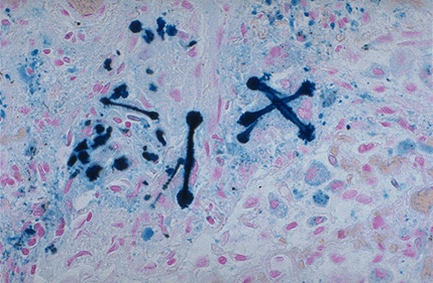
Asbestos Fibers in Lung Tissue
Notes:
Microscopic view of dyed asbestos fibers in lung tissue.

Slide 17
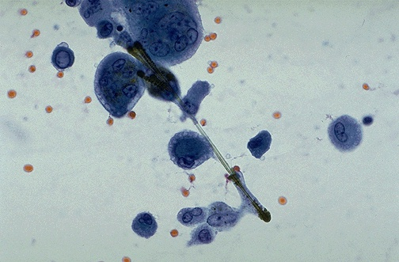
Asbestos Fiber in Lung Tissue
Notes:
Microscopic view of spear-like asbestos fiber in lung tissue.

Slide 18
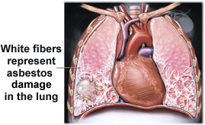
Lung Damage
Notes:
Artist’s depiction of alveoli scarring in lungs.

Slide 19
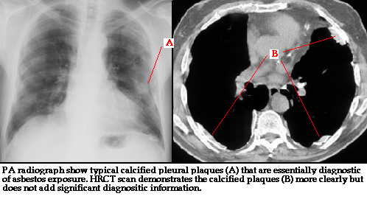
Pleural Plaques
Notes:
A fibrous thickening of the lining of the chest cavity that can be a precursor to lung cancer.

Slide 20
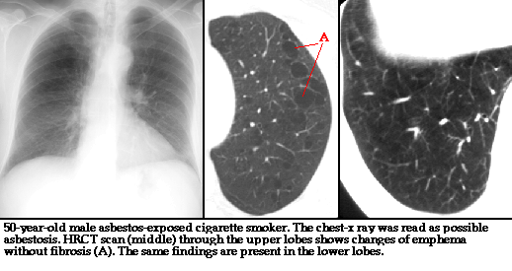
Smoker with Asbestosis
Notes:
A smoker exposed to asbestos fibers is at least 50 times more likely to develop lung cancer than the general public.

Slide 21
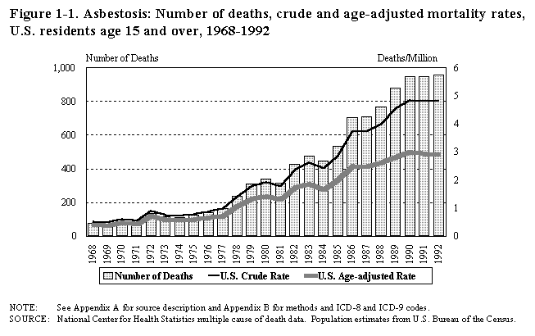
Death Rates
Notes:
Note: Significant exposure would likely have occurred to asbestos industry workers during the 1960s and 1970s, but due to the latency periods associated with asbestos-related diseases the mortality rates do not significantly increase until the 1980s and 1990s.

Slide 22
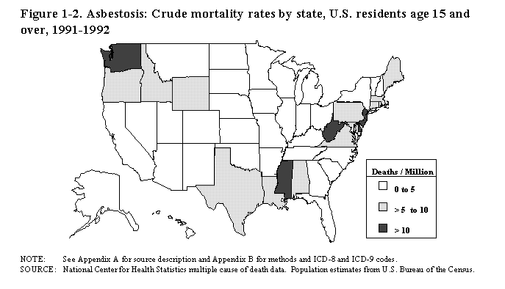
State Mortality Rates

Slide 23
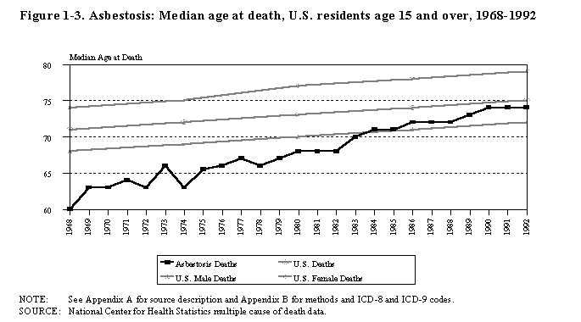
Median Age At Death
Notes:
The top gray line is the median age at death for U.S. females. The middle gray line is the median age at death for all U.S. deaths (male and female). The lower gray line is the median age at death for U.S. males. The black line is the median age at deaths related to asbestosis. Notice the effects of regulatory efforts to control asbestos exposure over the years.

Slide 24
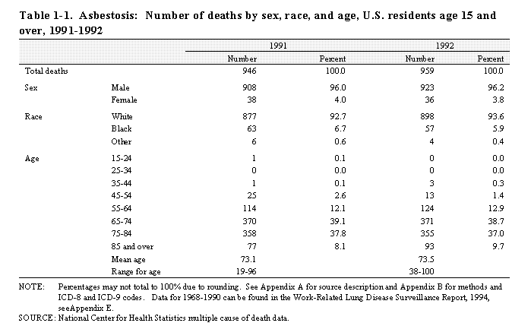
Deaths by Sex, Race and Age

Slide 25
Uses for Asbestos
Notes:
A description of the types of materials that contain asbestos follows.

Slide 26
Categories of Asbestos Containing Materials
Surfacing Materials
Thermal System Insulation
Miscellaneous Materials
Notes:
Basis categories of asbestos containing materials.

Slide 27
Surfacing Materials
ACM sprayed or troweled on surfaces (walls, ceilings, structural members.)
Acoustical Purposes
Decorative Purposes
Fireproofing

Slide 28
Thermal System Insulation
Insulation used to inhibit heat transfer or prevent condensation on pipes, boilers, tanks, ducts, and various other components of hot and cold-water systems and heating, ventilation and air conditioning systems.
Includes pipe lagging, pipe wrap, block, batt and blanket insulation, cements and muds, gaskets and ropes, etc.

Slide 29
Miscellaneous Materials
Floor Tile and Mastics
Ceiling Tile and Mastics
Roofing Felt
Concrete Pipe
Outdoor Siding
Fabrics

Slide 30
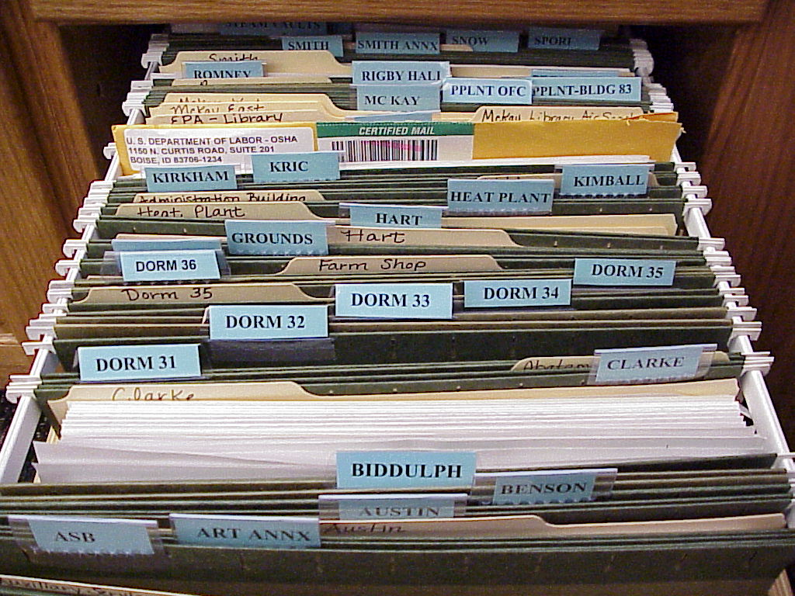
ACM File
Asbestos Survey Files are in the University Operations Business Services
Asbestos Containing Materials File
Notes:
This is the file that contains the laboratory reports on building materials surveyed for asbestos content.

Slide 31
BYU-Idaho Buildings Verification should always be made before disturbing any suspect materials.
Materials in buildings constructed before 1981 are presumed to be Asbestos Containing Materials (ACM) until proven otherwise by laboratory analysis.
Notes:
EPA regulations presume that the previously described categories of building materials contain asbestos in buildings constructed before 1981 unless laboratory analysis proves that the materials do not contain asbestos.

Slide 32
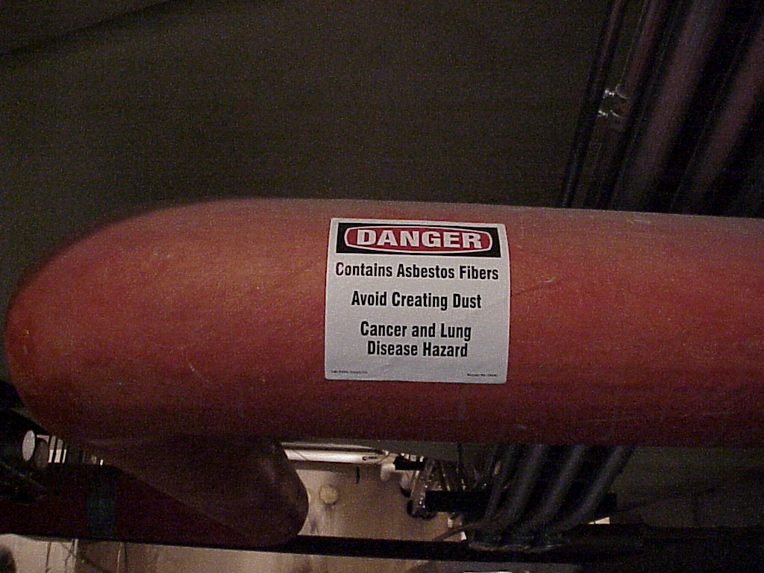
Asbestos Labeling
Notes:
ACM such as floor tiles, mastic and ceiling tiles are generally not labeled as asbestos containing materials. Many materials in mechanical rooms and non-public accessible areas are labeled, but do not assume that because a material is not labeled that it does not contain asbestos. Always check the asbestos survey file in the Physical Plant or contact the safety officer before disturbing any material that could possibly contain asbestos.

Slide 33
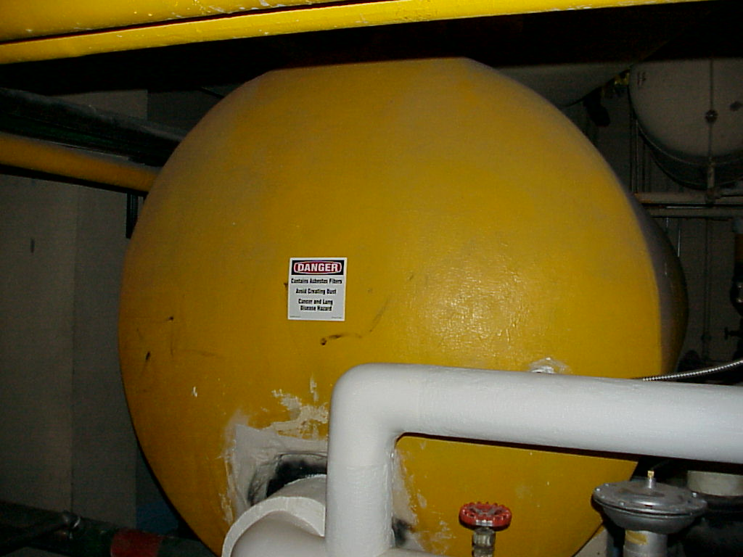
Asbestos Labeling

Slide 34
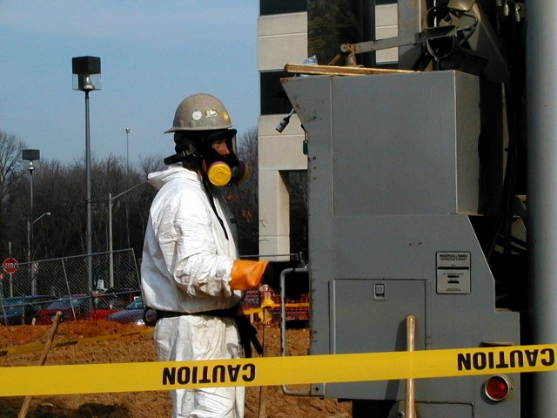
Personal Protective Equipment
Respirator
Eye Protection
Gloves
Disposable Coveralls
Notes:
Family members of asbestos industry workers and miners have been exposed to ACM because the routine work clothing of the asbestos workers had been contaminated. Asbestos abatement workers will wear some level of personal protective equipment, depending of the potential level of exposure to airborne asbestos fibers. The use of a respirator requires specific training and fit testing.

Slide 35
Maintenance Procedure if ACM might be encountered
Contact Risk Management (5604)
Contact the Assistant PPLT Director
Check the ACM Survey File in PPLT
Request laboratory analysis of material
If ACM present, request abatement by contractor
Do not disturb asbestos containing material
Use wet procedures if any material might inadvertently become airborne
Notes:
Never assume that a suspect material does not contain asbestos. Always assume that it does contain asbestos until laboratory analysis has proven otherwise.

Slide 36
Asbestos Abatement Requirements
Extensive Mandated EPA and OSHA training
Certifications
Documentation
Abatement/ Air Sampling Equipment
Personal Protective Equipment
Bonding
Lifetime Insurance Coverage Note: The Church has instructed CES institutions to contract asbestos abatement
Notes:
BYU-Idaho personnel are not authorized to conduct asbestos abatement operations.

Slide 37
Enforcement Action/ Liability
EPA- Up to $25, 000 per violation per day for serious violations; felony criminal penalties are also applicable to willful violations.
OSHA- Up to $7,000 per violation per day for serious violations and up to $70,000 per violation per day for willful or repeat violations; felony criminal penalties may also apply to willful violations.
Civil Liability- Responsible individuals and the institution could be subject to tort claims and civil litigation for negligence regarding employee health and safety.
Notes:
It is the objective of the university to protect its employees and students from health risks. It is also a priority to protect the resources of the institution from government sanctions and civil liability. Regulatory compliance and safe work practices are primary means of achieving these objectives. Please do your part.

Slide 38
Asbestos Awareness Review
Asbestos is a naturally occurring silicate. True or False
Chrysotile is a common type of asbestos. True or False
Any material that contains > 1% asbestos that can be crumbled, pulverized, or reduced to powder by hand pressure when dry is considered friable. True or False
Non friable asbestos containing materials can never become friable. True or False
Asbestos is primarily what type of health hazard? A. Inhalation, B. Ingestion, C. Absorption, D. Injection

Slide 39
Asbestos Awareness Review
Where is the BYU-Idaho Asbestos Survey File located?
Where can the BYU-Idaho Asbestos Policy be found?
How can you tell with certainty if a material contains asbestos? A. Close visual inspection, B. Comparison with known ACM, C. Laboratory Analysis, D. Flame test
The primary reason for complying with OSHA and EPA asbestos regulations is: A. To avoid enforcement action, B. to keep your supervisor happy, C. to protect your health and well-being, D. to protect the institution from liability.

